Slide 1
Hiring Heatmap – Final Project Handover Presentation
Data Analyst Intern – Syncner Presented by: Pavan R V

Slide 2
Project Objective & Scope
Goal
Build an end-to-end analytics framework supporting Hiring Heatmap product decisions.
Problem Statement
Job seekers, companies, and recruiters lack visibility into real-time hiring demand & skill trends.
Companies struggle to benchmark hiring competitiveness and identify talent supply gaps.
Project Scope
Market intelligence, product analytics, segmentation modeling, dashboards, investor storytelling.

Slide 3
Key Deliverables
Area | Output
Data pipeline | Simulated datasets & BigQuery warehouse
Analytics modelling | Skill co-occurrence, segmentation, LTV prediction
Market intelligence | Competitor matrix & TAM/SAM/SOM sizing
Dashboards | Job Demand & Segmentation Strategy (Power BI)
Product roadmap | Prioritized data-driven feature plan
Investor pitch | Insight-driven EDA & PPT appendix

Slide 4
Key Insights & Findings
Massive market: $8.6B TAM with strong growth runway
High-value segments: One customer segment shows highest LTV & largest user group
Product engagement: Core segments demonstrate 3×–5× higher event activity
Unit economics strengthening: Revenue trend diverging from spend
Implication: Clear path to growth and monetization with targeted execution.

Slide 5
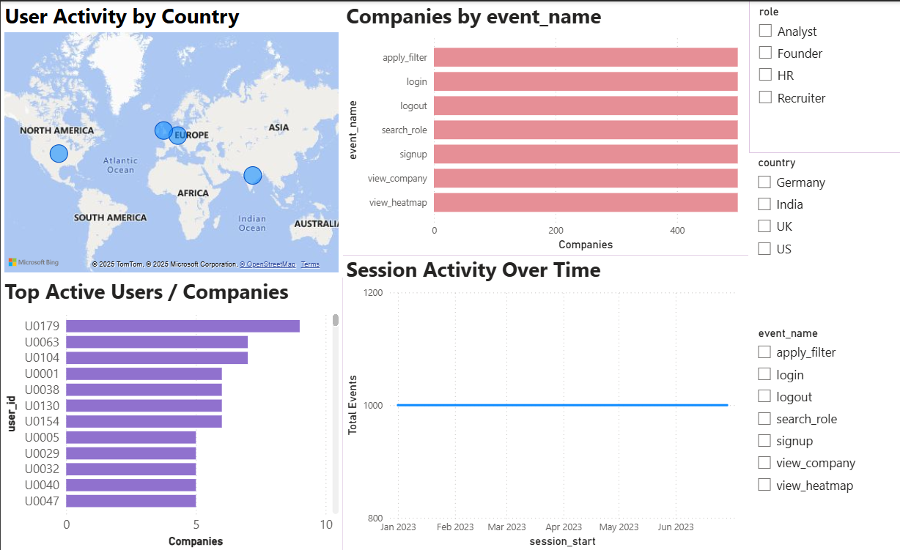
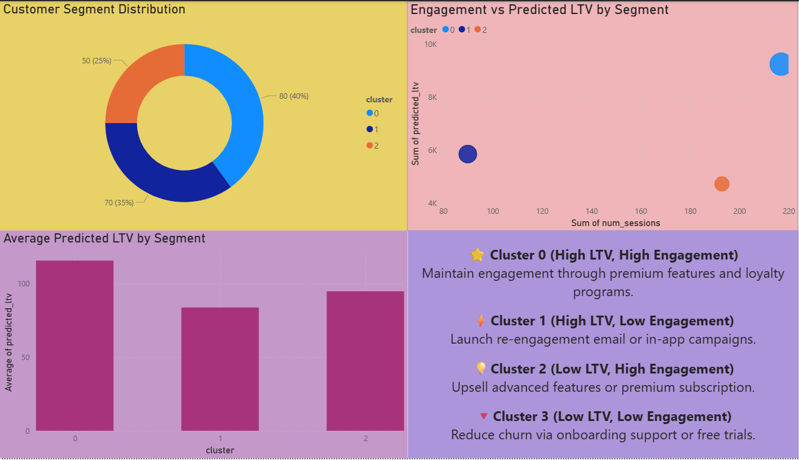
Analytics Dashboards
Enabled visibility into hiring trends by skill, role, location, company
Identified segments to prioritize for acquisition + retention strategy
Supports data-driven decision making for product & GTM

Slide 6
Product Roadmap
🟨 Now (MVP): Role search, heatmap, report export, job alerts 🟦 Next: Skill insights, company comparison 🟩 Later: Personalized dashboard, AI recommendations
Pitch takeaway: Aligns product delivery to revenue potential & highest-LTV segments.

Slide 7
What I Learned
Designing end-to-end analytics: data → insights → dashboards → recommendations
Real-world understanding of experimentation, segmentation & investor story building
Improved technical strengths (Python, Power BI, BigQuery) + communication

Slide 8
Final Handover & Next Steps
Category | Status
Deliverables organized | ✔
Documentation + Readme | ✔
Dashboards ready to use | ✔
Models reproducible | ✔

